Slide 1
Milestone Presentation (2)
Milestone 3: Submit single-block tasks
16.12.2021

Slide 2
Overview
Working Progress
Demo Code + Visuals
Difficulties
Next steps

Slide 3
Working Progress
Used programming language: Jason
Rewriting the whole project in jason
Getting used to jason

Slide 4
Code
Live-Demo
Git:
https://github.com/DieMango/PiB_Bri_Och/

Slide 5
Difficulties
Having to redo everything in Jason
And dealing with the same problems in different ways
Getting used to Jason
Eg. having to describe functions like absolut value
Bad time management

Slide 6
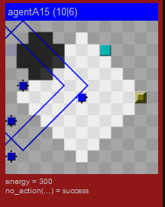
Difficulties (2)
Movementfunction isnt working right
Agents get stuck
Possible solution: Agents get an random field in their view to move there, then get a new one, eccept there is a higher goal than can be achieved (eg taskblock, dispenser, goalzone)

Slide 7
Next Steps (1) finishing Milestone 3
Implementing Java functions for more complex pathfinding (and maybe other stuff)
Submitting single-block tasks
Grabbing (needed) blocks with an agent
Finding and reaching goal-zones
Storing positions of important entities

Slide 8
Next Steps (2)
Achieving Milestone 4
Coordinating multiple agents
Sharing information between agents

